Slide 1


Pulsed load analysis
Electric Power Load Analysis (EPLA)
Revision of 1 August 2026
Dr. Norbert Doerry
http://doerry.org/norbert/MarineElectricalPowerSystems/index.htm
© 2026 by Norbert Doerry
This work is licensed via: CC BY 4.0 (https://creativecommons.org/)

Slide 2
Essential Questions
What are the characteristics of pulsed loads? | Understand
What are system implications of pulsed loads on ac systems powered by generators? Powered by transformers? | Understand
What are system implications of pulsed loads on systems powered by power electronic converters? | Understand
What can be done to mitigate the impact of pulsed loads on system performance? | Understand
How is pulsed load analysis performed? | Apply

Slide 3
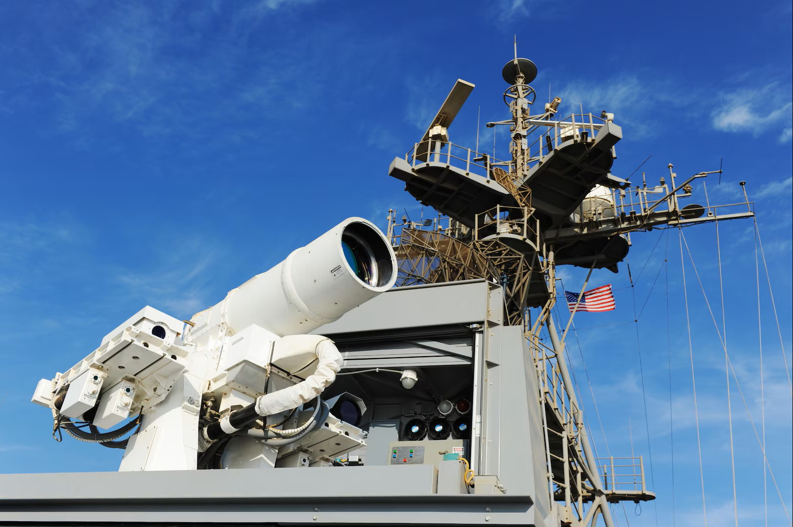
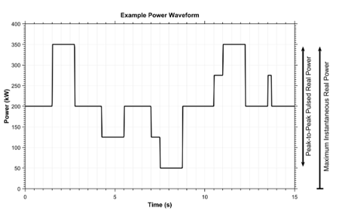
Introduction
A pulse is a power excursion with a short rise time, short fall time, and a duration of at least one cycle and less than 10 seconds (per MIL-STD-1399-300-1)
Infrequent pulsed loads – occur no often than once every 120 seconds
Repetitive Pulse loads – occur more often and may have multiple levels

Slide 4
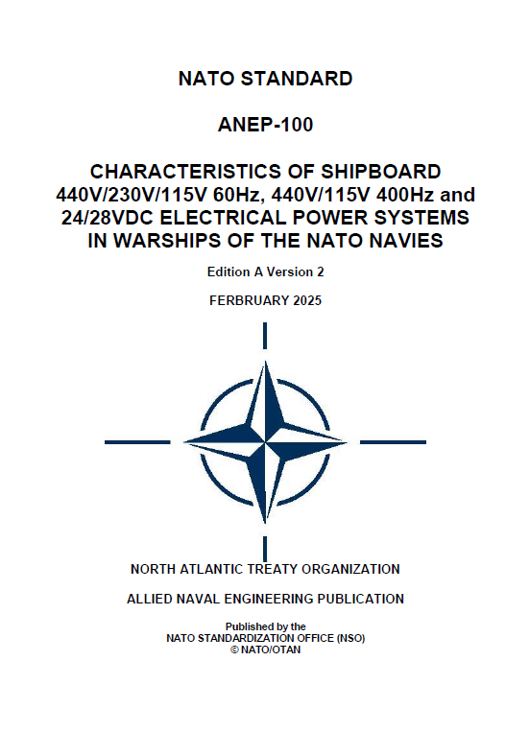
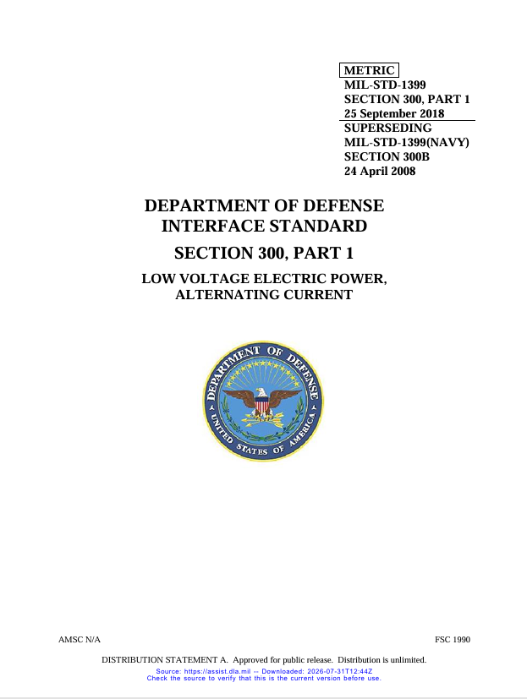
Standards
MIL-STD-1399-300-1
  Low Voltage a.c. Power
MIL-STD-1399-300-2
  Medium Voltage a.c. Power
NATO ANEP-100 (STANAG 1008)
  NATO Standard
  440V/230V/115V 60Hz
  440V/115V 400 Hz
  24/28VDC

Slide 5
Infrequent Pulsed Loads
Present a pulse no more than once every 120 seconds
  Most pulsed loads can present a pulse more often under normal operations
MIL-STD-1399-300-1 and MIL-STD-1399-300-2
  Limited by ramp rate of 30% of the online source rating (VA) per second

Slide 6
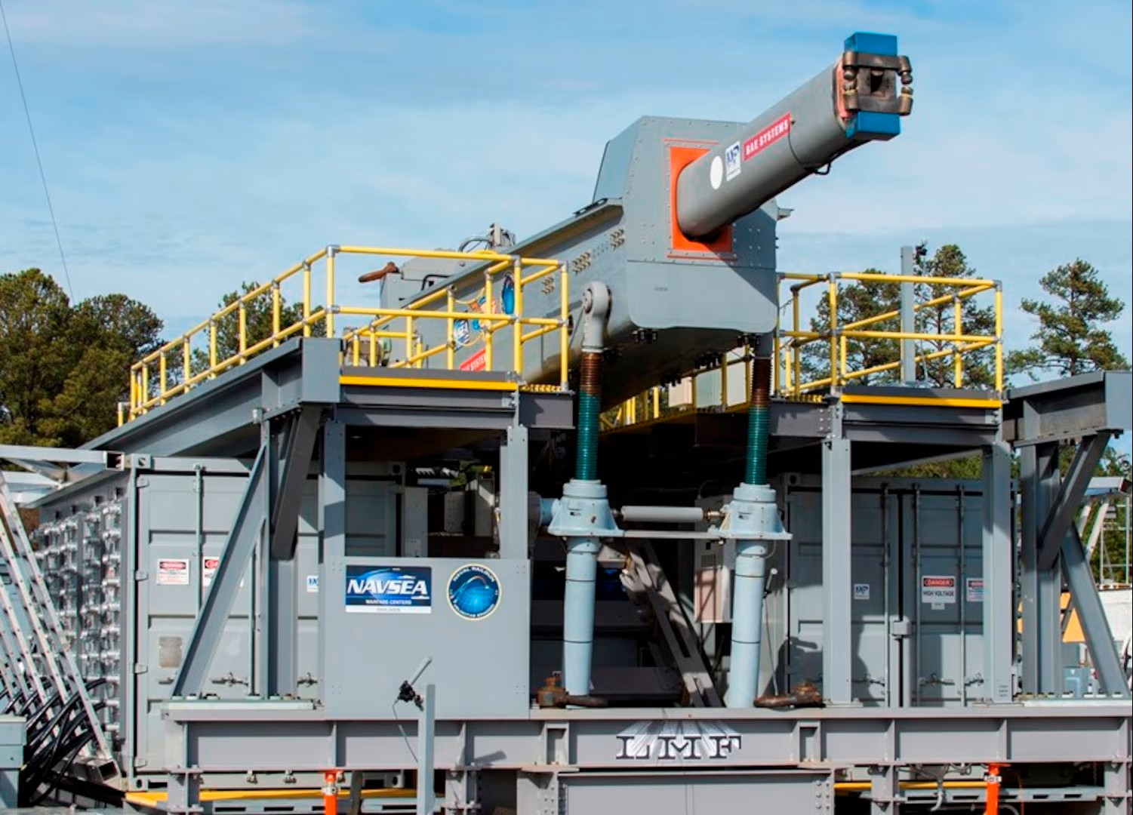
Repetitive Pulsed Loads (MIL-STD-1399-300-1)
Should meet the following
  Pulsed power deviation limit in the time domain
  Pulsed power magnitude/frequency in the frequency domain
  Pulsed Power total signal distortion limit.
Also subject to inrush current requirements
US Navy Photo

Slide 7
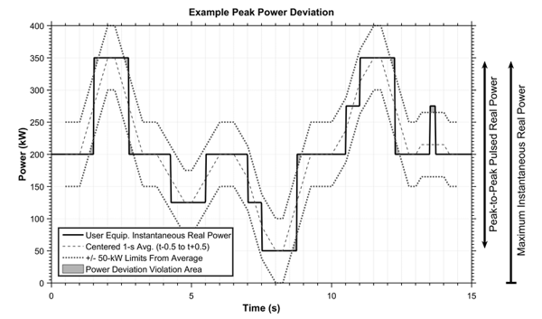
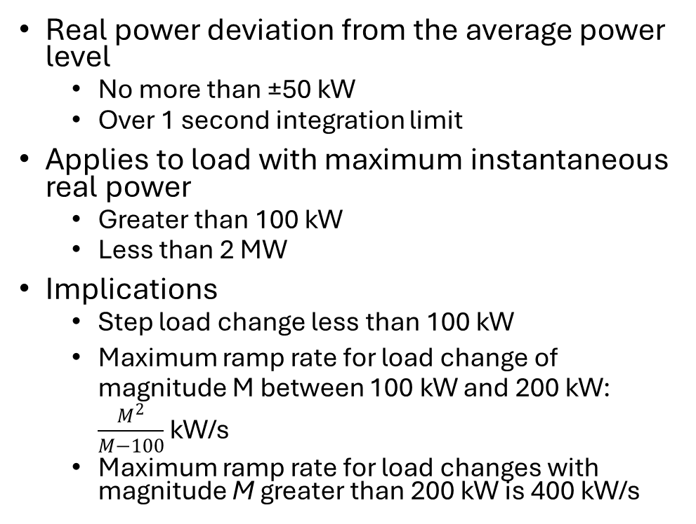
Pulsed Power Deviation Limit in the Time Domain
Real power deviation from the average power level
  No more than ±50 kW
  Over 1 second integration limit
Applies to load with maximum instantaneous real power
  Greater than 100 kW
  Less than 2 MW
Implications
  Step load change less than 100 kW
  Maximum ramp rate for load change of magnitude M between 100 kW and 200 kW: $\frac{M^{2}}{M−100}$ kW/s
  Maximum ramp rate for load changes with magnitude M greater than 200 kW is 400 kW/s
MIL-STD-1399-300-1
Load change has a constant ramp rate
Load has a constant value before and after ramp for .5 seconds

Slide 8
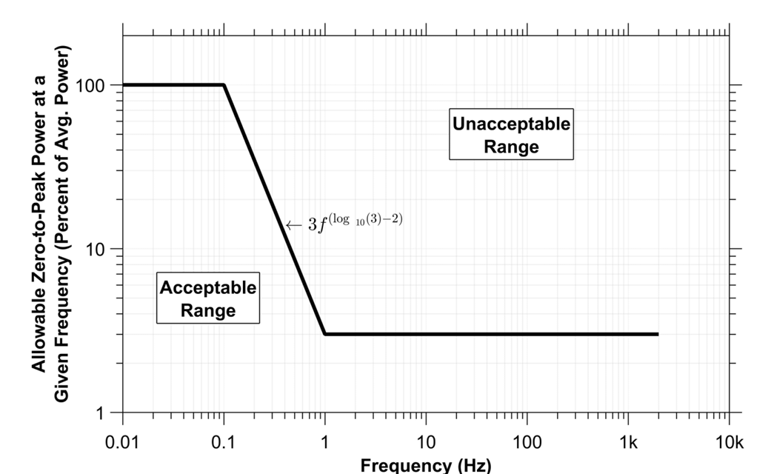
Pulsed Power Magnitude/Frequency in the Frequency Domain
Applies to pulsed power loads > 100 kW
Peak to Peak real pulsed power ≤ 25% of prime mover real power rating.
The frequency content of the real power waveform minus the average power over a 100 second average is determined using a Discrete Fourier Transform (DFT)
  Long Window is 100 seconds (< 1 Hz)
  Short sliding window is 4 seconds with each window having a 3 second overlap with the previous window (≥ 1 Hz)
  Resulting frequency content should fall within the Acceptable Range
MIL-STD-1399-300-1

Slide 9
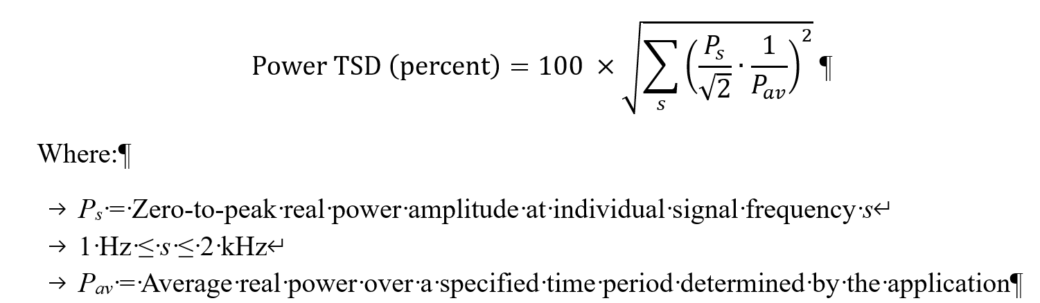
Pulsed Power total signal distortion limit
Power total signal distortion (TSD)
  < 5% for frequencies between 1 Hz to 2 kHz.
  Average real power calculated over 100 seconds
  TSD calculated over 4 second rolling window
  Maximum TSD for all windows used

Slide 10
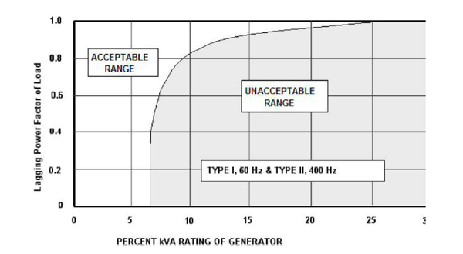
ANEP-100 (STANAG 1008) Pulsed load limit
The ANEP-100 limit for pulsed load is based on the graph to the right
  X-axis is the ratio of the apparent power rating of the pulsed load to the apparent power rating of online generator sets expressed as a percentage.
  Y-axis is the power factor of the pulsed load.
Pulsed loads limited to 25% of the rated apparent power of online generator sets.
ANEP-100

Slide 11

Impact of Pulsed Loads on Generator Sets
Metal fatigue and throttle wear
  Torque Pulsations
  Rapid Thermal Cycling
  Steel Lamination Losses
Paralleled generators of different type
  Smaller genset transiently takes on more load and could trip off line if too much
May be unable to meet frequency and voltage power quality requirements
US Navy Photo

Slide 12
Impact of Pulsed loads on Transformers
Degradation of insulation
  Rapid thermal cycling
  High transient Electromagnetic forces
  High core losses
Transformer inductances and resistances may interact with pulses such that voltage power quality requirements are not met.

Slide 13

Impact of Pulsed Loads on Power Electronic Converters
Should be able to maintain voltage power quality at the converter output
  Fast switching times
  Sufficient internal energy storage
Should be able to maintain current power quality at the converter input
  Fast switching times
  Sufficient internal energy storage
US Navy Photo

Slide 14
Pulsed Load Mitigation
Energy storage
  Fulfilling ESM-F4 functionality
  UPS style may be effective, but limits ability to share energy storage among multiple pulsed power loads
  Pulsed power bus enables sharing, but requires circuit protection and significant cabling
  Energy storage systems at switchboards enable power sharing
    Can also be used for power factor correction and harmonic current cancelation
Power redirection
  Use propulsion motor (or other large loads) as a virtual energy storage system
    Ship speed not significantly impacts by lower propulsion power during the pulse
  Propulsion motor must be operating at a minimum speed such that sufficient power may be redirected
  When used, can extend life of energy storage systems and prime movers.
Control negotiations
  Enables power system and pulsed loads to negotiate values of the interface
DC distribution systems
  Enables higher ramp rates
  Reduces risk associated with paralleling multiple generator sets of different sizes
  Currently no existing standards cover pulsed loads with MVDC systems..

Slide 15
Pulsed load analysis – Pulsed load meeting interface requirements
Original Equipment Manufacturer (OEM) usually performs analysis and testing to demonstrate conformance to interface requirements
Some interface requirements depend on ratings of online generator sets
  Ship designer has role in ensuring successful pulsed load integration
If interface requirements are not easily met, recommend allocating space, weight, power and cooling (SWAP-C) for mitigation equipment

Slide 16
Pulsed load analysis – determining if power quality is maintained
Usually starts in Preliminary / Contract Design
  May be earlier if required
Requires detailed transient analysis
  Waveform level models
  Incorporate actual inductances, capacitances, and resistances
    Time periods can be shorter than the period of the fundamental frequency.
Should cover a series of scenarios to cover various operational situations the ship may encounter
Initially used to bound values for SWAP-C
As system models become more representative of actual hardware:
  Determine whether SWAP-C should be used for mitigation efforts
  Determine which mitigation efforts should be used

Slide 17
Pulsed load analysis – determining impact on prime movers
Generally insufficient information on prime mover data sheets
May need to contract with OEM to determine impact
Alternately could perform tests in a test site.

